Slide 1
Linked List II Session 04
Course : Data Structures
Effective Period : 2023

Slide 2
Learning Outcomes
At the end of this session, students will be able to:
LO 1: Explain the concept of data structures and its usage in Computer Science
LO 2: Illustrate any learned data structure and its usage in application
LO 3: Apply data structures using C

Slide 3
Outline
Circular Single Linked List
Doubly Linked List
Circular Doubly Linked List

Slide 4
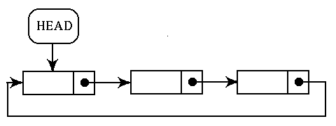
Circular Single Linked List
In circular, last node contains a pointer to the first node
We can have a circular singly linked list as well as a circular doubly linked list.
There is no storing of NULL values in the list

Slide 5
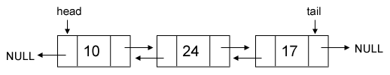
Doubly Linked List
Double/Doubly linked list or two-way linked list is a linked list data structure with two link, one that contain reference to the next data and one that contain reference to the previous data.
struct tnode {
int value;
struct tnode *next;
struct tnode *prev;
};
struct tnode *head = 0;
struct tnode *tail = 0;

Slide 6
Doubly Linked List: Insert
Just like in a single linked list, first we should allocate the new node and assign the value to it, and then we connect the node with the existing linked list.
Supposed we want to append the new node behind the tail.
struct tnode *node =
(struct tnode*) malloc(sizeof(struct tnode));
node->value = x;
node->next = NULL;
node->prev = tail;
tail->next = node;
tail = node;

Slide 7
Doubly Linked List: Insert
Supposed we want to insert a new node in a certain position (any location between head and tail)
struct tnode *a = ??;
struct tnode *b = ??;
// the new node will be inserted between a and b
struct tnode *node =
(struct tnode*) malloc(sizeof(struct tnode));
node->value = x;
node->next = b;
node->prev = a;
a->next = node;
b->prev = node;

Slide 8
Doubly Linked List: Delete
There are 4 conditions we should pay attention when deleting:
The node to be deleted is the only node in linked list.
The node to be deleted is head.
The node to be deleted is tail.
The node to be deleted is not head or tail.

Slide 9
Doubly Linked List: Delete
If the node to be deleted is the only node:
free(head);
head = NULL;
tail = NULL;
If the node to be deleted is head:
head = head->next;
free(head->prev);
head->prev = NULL;

Slide 10
Doubly Linked List: Delete
If the node to be deleted is tail:
tail = tail->prev;
free(tail->next);
tail->next = NULL;

Slide 11
Doubly Linked List: Delete
If the node to be deleted is not in head or tail:
struct tnode *curr = head;
while ( curr->next->value != x ) curr = curr->next;
struct tnode *a = curr;
struct tnode *del = curr->next;
struct tnode *b = curr->next->next;
a->next = b;
b->prev = a;
free(del);

Slide 12
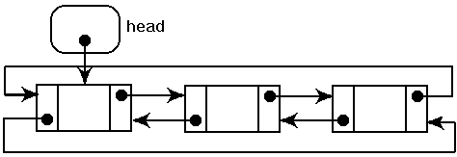
Circular Doubly Linked List
It is similar with circular single linked list, but total pointer in each node here is 2 (two) pointers.

Slide 13
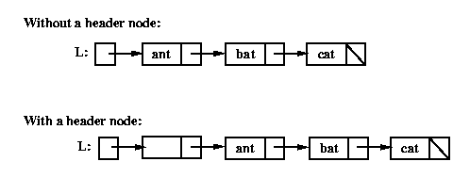
Header Linked List
A header linked list is a special type of linked list which contains a header node at the beginning of the list.
So, in a header linked list, START (L) will not point to the first node of the list but START (L) will contain the address of the header node.

Slide 14
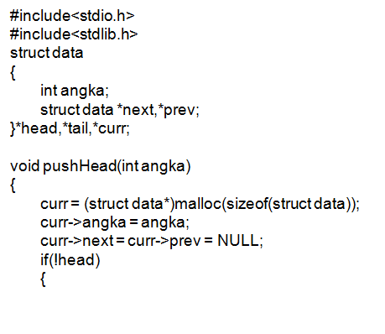
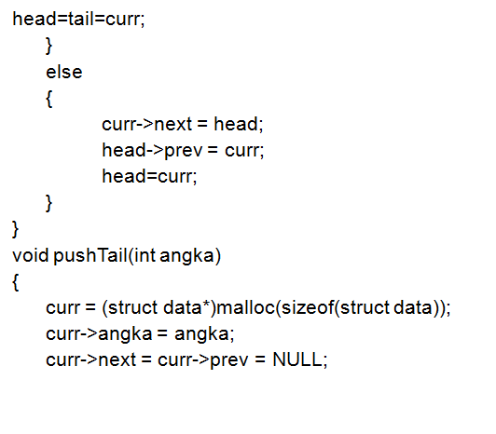
Programming Examples (Double Linked list)

Slide 15
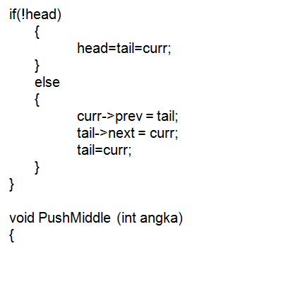
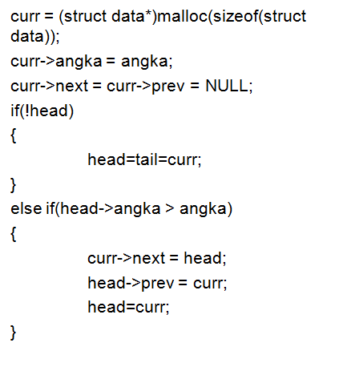
Programming Examples (Double Linked list)

Slide 16
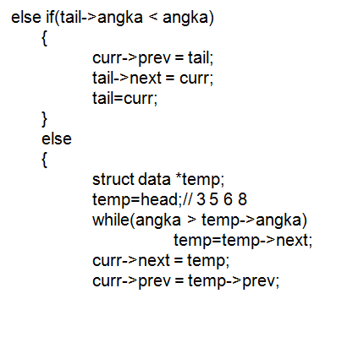
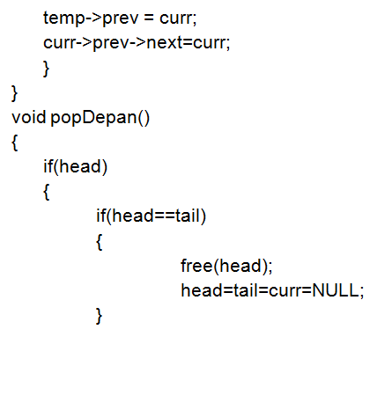
Programming Examples (Double Linked list)

Slide 17
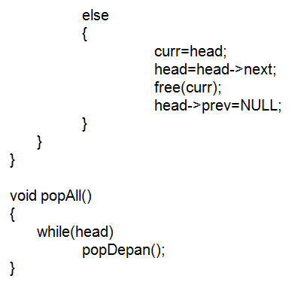
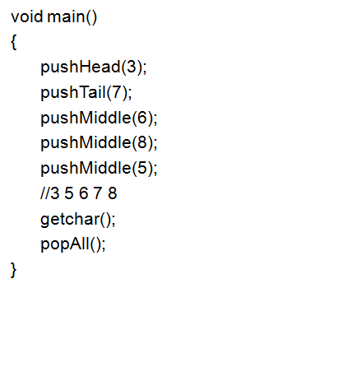
Programming Examples (Double Linked list)

Slide 18
References
S. Sridhar. 2015. Design and Analysis of Algorithms. Oxford University Press. New Delhi. ISBN: 9780198093695. Chapter 5
Reema Thareja. 2014. Data structures using C. Oxford University Press. New Delhi. ISBN:9780198099307. Chapter 6
Thomas H. Cormen, Charles E. Leiserson, Ronald L. Rivest, & Clifford Stein. (2009). Introduction to Algorithms. 03. The MIT Press. London. ISBN: 9780262033848. Chapter 10
Doubly Linked List, https://visualgo.net/en/list?slide=6

